Slide 1
Neurox: 3D Neurological Brain Segmentation
Guide Name:
Dr. Jayaram B
Team Members:
Munta Sai Karthik – 22BCE5060
Gotam Sai Varshith – 22BCE1605
Manideep Sandireddy – 22BCE1434

Slide 2
PROBLEM STATEMENT
Analyzing brain MRIs is a complex and time-consuming process
Current AI systems typically focus on a single disease or a single task (e.g., classification or segmentation)
Most existing research emphasizes model development rather than end-to-end clinical systems
Core Problem:
There is a lack of unified, interpretable, and disease-aware systems capable of performing multi-disease analysis on a single MRI scan.
Existing approaches often fail to preserve anatomical correctness while handling multiple diseases simultaneously

Slide 3
MOTIVATION
Why This Problem Matters
Radiologists do not use separate AI models for each disease.
Incorrect task assumptions (e.g., performing Alzheimer’s segmentation) can lead to misleading or clinically invalid outputs.
Lack of uncertainty estimation reduces trust and adoption of medical AI systems.
Motivation
To design a system that reflects real clinical reasoning rather than benchmark-only experimental setups

Slide 4
OBJECTIVES
Project Objectives
Design a unified pipeline for multi-disease brain MRI analysis
Perform disease-appropriate inference:
Detection only (Alzheimer)
Detection + segmentation (Tumor, Stroke)
Preserve anatomical correctness during inference
Provide interpretable outputs with uncertainty awareness
Objective is system-level correctness, not SOTA accuracy claims.

Slide 5
Literature Review
Paper / Year | Method | Key Strength | Critical Drawback | Literature Gap
TransBTS: Multimodal Brain Tumor Segmentation Using Transformer (2021) | 3D CNN + Transformer encoder–decoder for tumor segmentation | First integration of Transformer for 3D MRI segmentation capturing local + global features | Limited modality fusion strategy; high computation | Needs better multi-modal fusion & uncertainty
CKD-TransBTS: Clinical Knowledge Fusion (2022) | Hybrid Transformer + CNN with modality-correlated cross-attention | Effective multi-modal feature extraction respecting radiological signals | Still heavy architecture; limited uncertainty modeling | Haven’t extended to multi-disease tasks
Multi-encoder nnU-Net with Self-Supervised Pretraining (2025) | Multi-encoder CNN with modality-specific encoders | Handles missing modalities & improves segmentation feat capture | No transform-based global context | Integrates modality separation without Transformers
MMAformer: Multiscale Modality-Aware Transformer (2024) | Multiscale transformer with cross-modal downsampling | Captures complementary features across MRI modalities | Few benchmark comparisons | Global context fusion still underexplored
ResMT: CNN + Swin UNETR for Glioma Grading (2024) | Hybrid 3D CNN + pre-trained Swin UNETR | Combines segmentation + grading; strong AUC | Uses pretrained segmentation increases computation | Needs true segmentation + diagnosis integration

Slide 6
Literature Review
Paper / Year | Method | Key Strength | Critical Drawback | Literature Gap
Improved Brain Tumor Segmentation With SegFormer (2025) | Transformer-based segmentation model | Strong boundary delineation with transformer spatial attention | Limited multi-modal integration | Comparison of scale trade-offs missing
Vision Transformers in Multi-Modal Brain Tumor MRI (2023) | Survey of CNN & ViT models | Summarizes transformer trends in segmentation | Does not propose new method | Lacks gap behind multi-task inference
MM-MSCA-AF Multi-Modal MRI Tumor Segmentation (2025) | Multi-scale contextual attention fusion | Improved multi-modal contextual integration | Specific to multi-modal fusion only | Not evaluating uncertainty
Ranjbarzadeh et al. (2021) Attention-Mechanism CNN | Cascade CNN with attention and preprocessing | Effective segmentation with reduced overfitting | Computation still high; no global context | Lacks transformer or uncertainty
UALE: Ultra-Lightweight Ensemble (2025) | Uncertainty-aware ensemble CNN | Uncertainty quantified with lightweight design | Not highly accurate vs state-of-art | No segmentation per disease type

Slide 7
Literature Review
Paper / Year | Method | Key Strength | Critical Drawback | Literature Gap
Abidin et al. (2024) Review of DL-based MRI Tumor Segmentation | Review analyzing models and trends | Good overview of CNN/ViT hybrid models | No new method proposed | Utility of uncertainty, multi-task missing
Alsubaie (2024) Alzheimer DL Review | Systematic review on AD detection | Summarizes deep methods & data issues | Does not compare segmentation | Gap: multi-disease integration
Herman Herzog (2020) Unknown | Uncertainty integration exploration | Discusses integrating uncertainty into DL models | Not full research paper | Uncertainty modeling is still evolving
nnFormer: Volumetric Medical Image Segmentation (2023) | Transformer-based volumetric segmentation | Strong performance in 3D context | Heavy computation | Not evaluated for multi-disease inference
TransUNet (2021) Transformers for Medical Segmentation | Hybrid CNN-Transformer | Good at global context + spatial details | Not directly for MRI tumor | Does not include uncertainty

Slide 8
IDENTIFIED RESEARCH GAPS
Key Gaps in Existing Work
No unified multi-disease inference pipeline
No disease-aware task separation
Poor anatomical consistency in visualization
Lack of uncertainty-aware outputs
Absence of end-to-end interpretable systems
These gaps motivated the proposed system design.

Slide 9
PROPOSED SYSTEM OVERVIEW
Input
3D Brain MRI (NIfTI format)
Outputs
Disease presence probabilities
Lesion segmentation (where applicable)
Uncertainty estimates
Quantitative lesion metrics
2D/3D visualization
Structured report
The focus is interpretability and correctness, not automation claims.

Slide 10
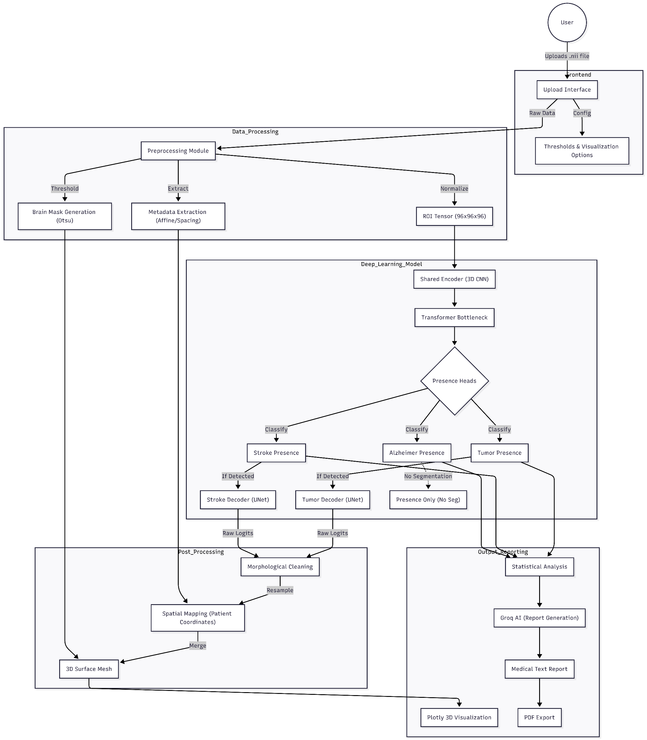
SYSTEM ARCHITECTURE

Slide 11
SYSTEM ARCHITECTURE
Architecture Highlights
Modular design
Shared feature encoder
Transformer bottleneck for global context
Disease-specific heads
Independent post-processing and visualization modules
Architecture prioritizes clarity and extensibility.

Slide 12
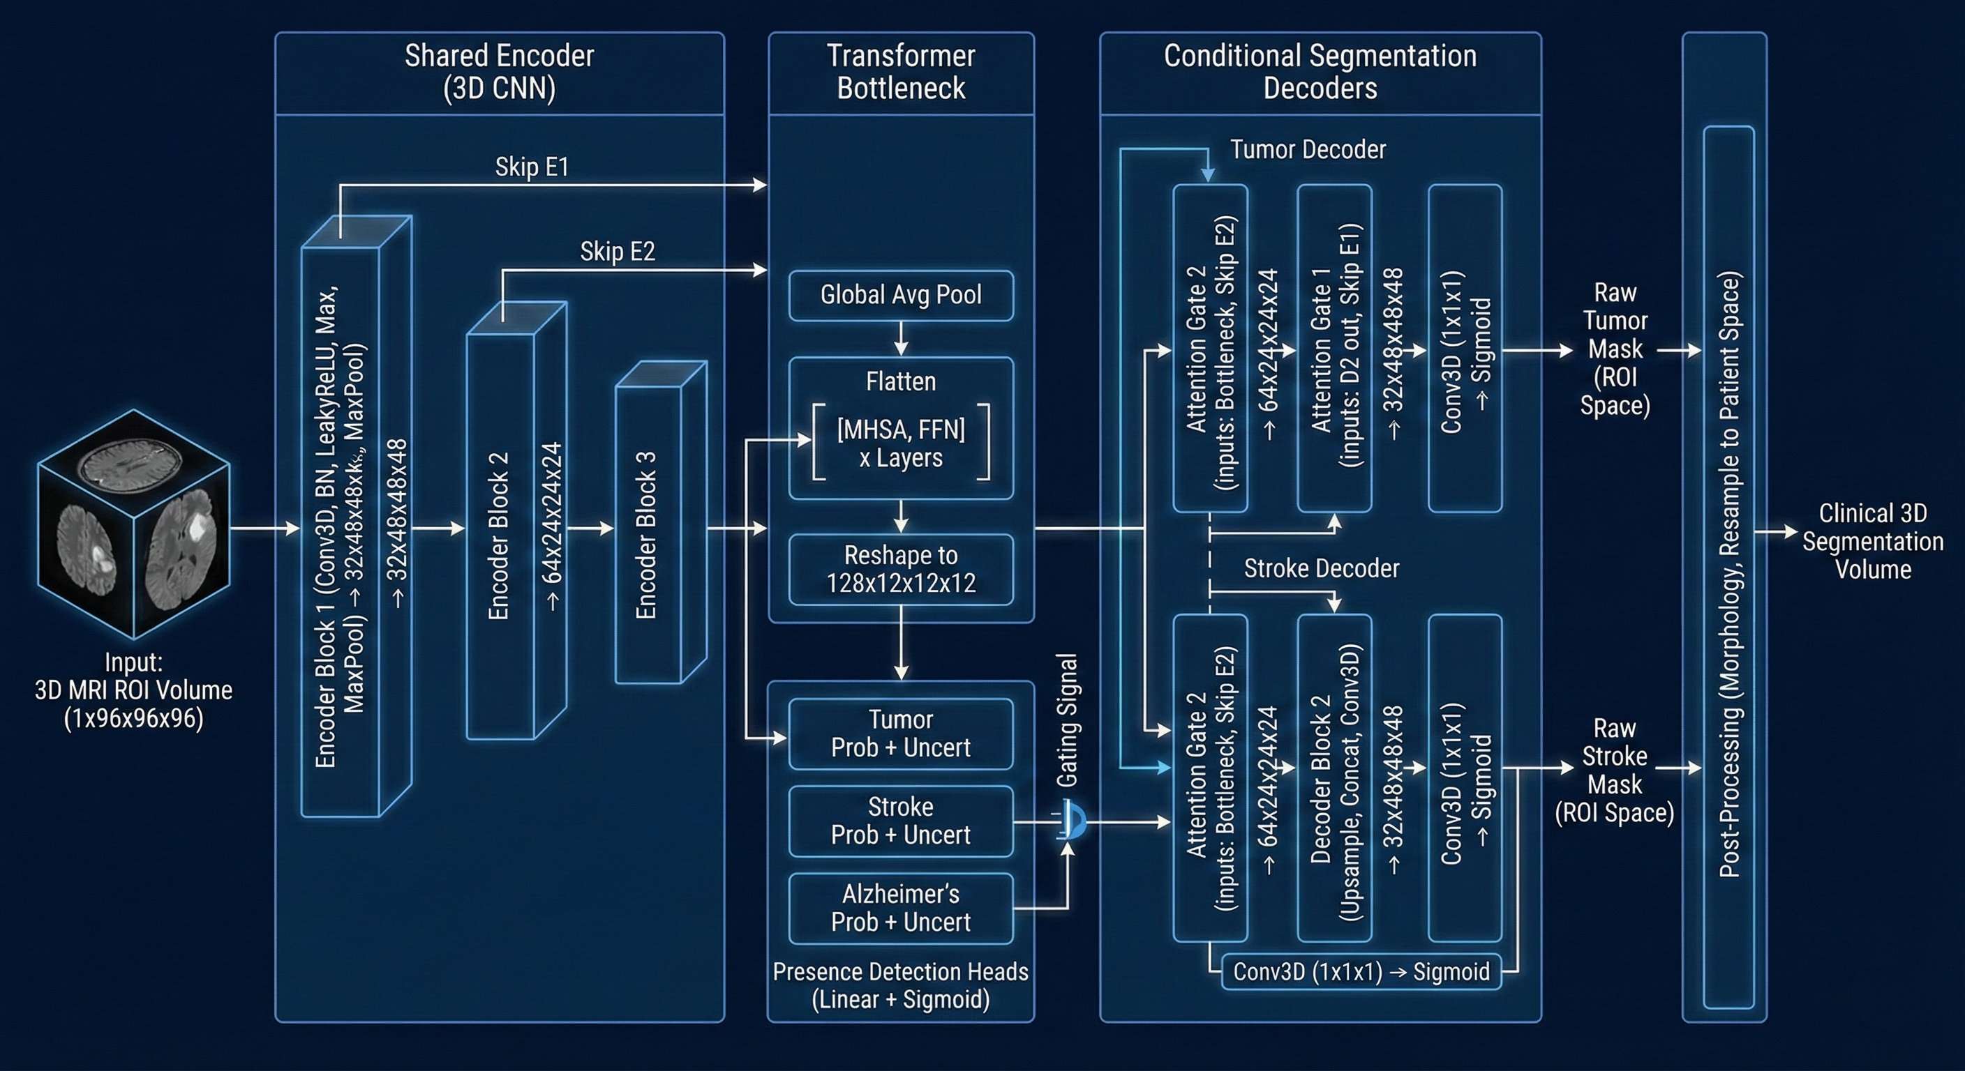
MODEL ARCHITECTURE

Slide 13
MODEL ARCHITECTURE
Core Components
Shared 3D CNN Encoder
Transformer Bottleneck
Disease Presence Heads
Segmentation Decoders (Tumor, Stroke)
Monte-Carlo Dropout for uncertainty
Disease-Aware Design
Alzheimer → Presence only
Tumor / Stroke → Presence + Segmentation
This avoids methodological misuse of datasets.

Slide 14
WORKFLOW / ALGORITHM
End-to-End Workflow
MRI upload & validation
Preprocessing & ROI extraction
Feature extraction
Disease detection
Uncertainty estimation
Conditional segmentation
Anatomical post-processing
Patient-space reconstruction
Visualization & reporting
Each step is deterministic and traceable.

Slide 15
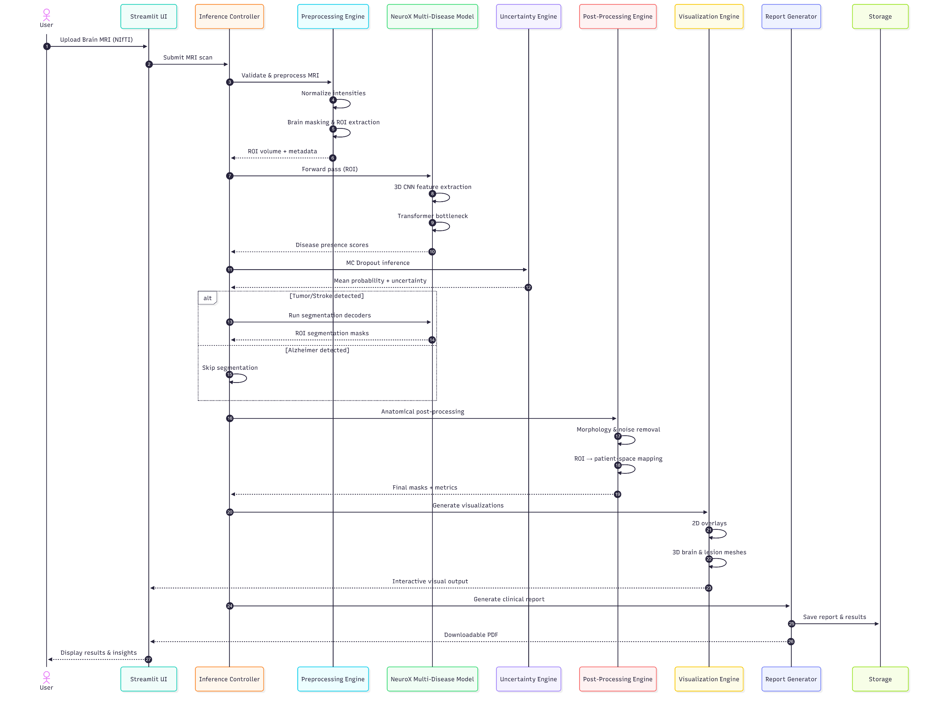
UML / SEQUENCE DIAGRAM

Slide 16
UML / SEQUENCE DIAGRAM
Purpose
Shows interaction between:
User
UI
Inference pipeline
Model
Visualization & reporting
Demonstrates system-level understanding.

Slide 17
FEASIBILITY ANALYSIS
Computational Feasibility
ROI-based inference
Conditional execution
Operational Feasibility
Streamlit UI
Local or server deployment
Feasible within academic infrastructure.
Technical Feasibility
Uses established deep learning architectures
Supported by existing frameworks
Data Feasibility
Public datasets: BraTS, ISLES, ADNI

Slide 18
RESULTS & OUTPUTS
Demonstrated Outputs
Disease presence probabilities
Uncertainty estimates
Segmentation masks
3D anatomical visualization
PDF report
Qualitative results shown; no inflated metric claims.

Slide 19
NOVELTY & CONTRIBUTIONS
Actual Contributions
Disease-aware multi-task system
Conditional execution pipeline
Anatomically consistent patient-space reconstruction
End-to-end interpretable system
Novelty lies in system integration, not model invention.
What is NOT claimed
No new neural architecture
No benchmark superiority claims

Slide 20
LIMITATIONS
Current Limitations
No large-scale benchmarking
No external clinical validation
Performance depends on training data quality
These limitations are explicitly acknowledged.

Slide 21
FUTURE WORK
Planned Extensions
Quantitative benchmarking
Additional neurological conditions
Improved uncertainty calibration
Dataset expansion and validation

